Slide 1
DBMS Relational Model and Relational Algebra

Slide 2
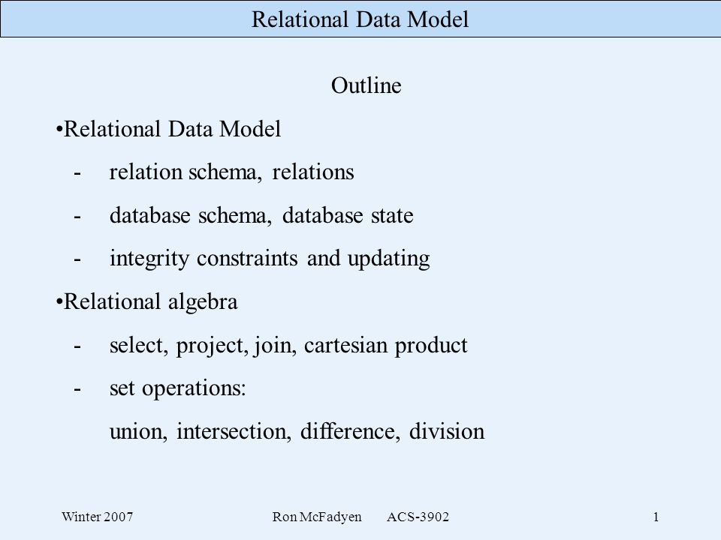

Slide 3
Relational Model was proposed by E.F. Codd to model data in the form of relations or tables.
After designing the conceptual model of Database using ER diagram, we need to convert the conceptual model in the relational model which can be implemented using any RDMBS languages like Oracle SQL, MySQL etc

Slide 4
RDBMS
RDBMS is a subset of DBMS.
A relational database refers to a database that stores data in a structured format, using rows and columns.
It is "relational" because the values within each table related to each other.
Tables may also be related to other tables.
The relational structure makes it possible to run queries across multiple tables at once.

Slide 5
RELATIONAL MODEL (RM) represents the database as a collection of relations.
A relation is nothing but a table of values.
Every row in the table represents a collection of related data values.
These rows in the table denote a real-world entity or relationship.

Slide 6
Some popular Relational Database management systems are:
DB2 and Informix Dynamic Server - IBM
Oracle and RDB – Oracle
SQL Server and Access - Microsoft

Slide 7
Relation
Tuple
Attribute
Domain- The intersection column and row in a relational table which represents data of entity is called as Domain.
In a relational table a domain can have a single value or no value.

Slide 8
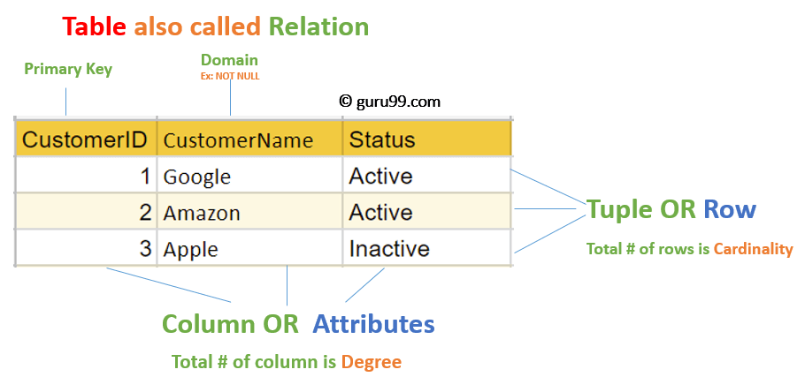

Slide 9
Relational Database Schema
The term schema refers to the organization or structure of data in relational database.
1. Relational Schema
Describe structure of relation(table)
Number of Attributes associated with relation.
2. Relational database Schema
Describe structure of relational database.
Number of Attributes associated with relation.

Slide 10
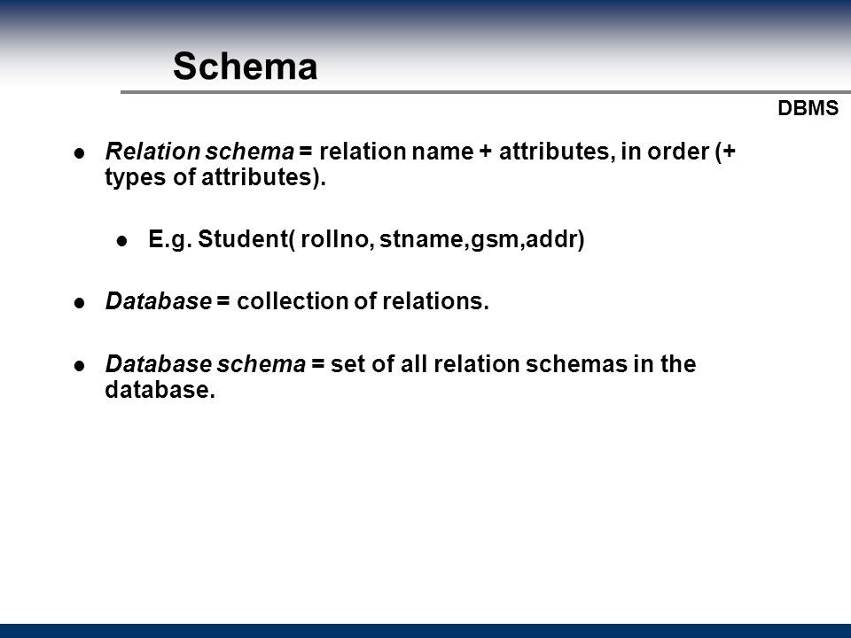

Slide 11
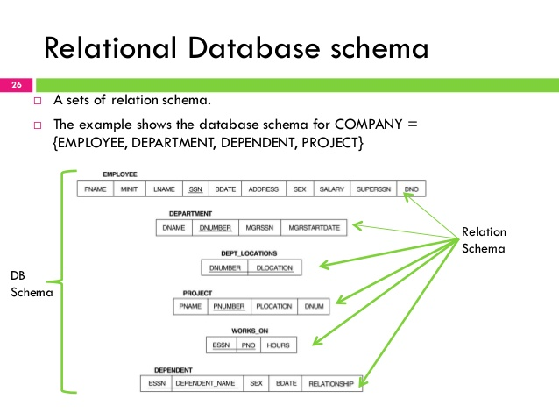

Slide 12
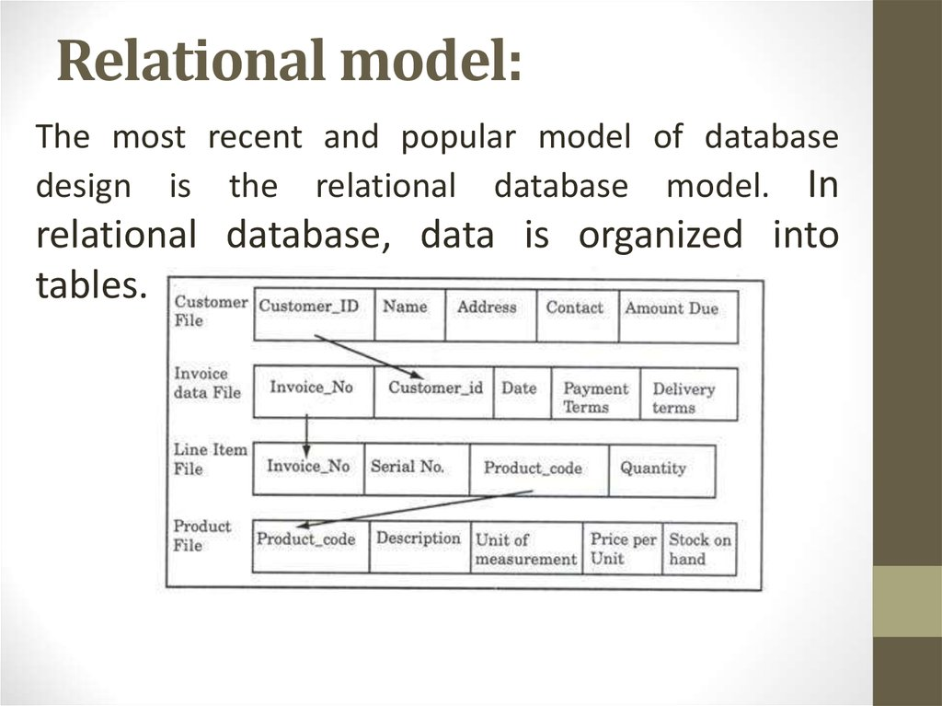

Slide 13
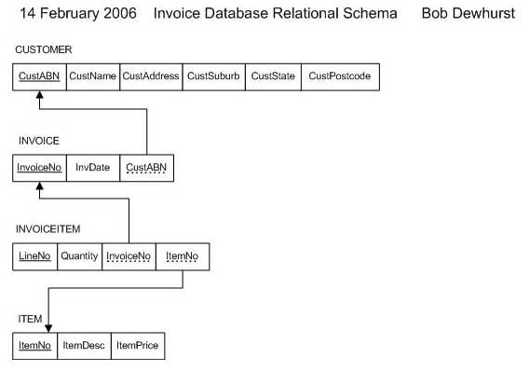

Slide 14
Relational Model Constraints
Make sure – authorized user make modification to data base.
Changes should not lead to loss of data consistency and correctness.
These concepts make sure that only correct and complete data is stored in data base.

Slide 15
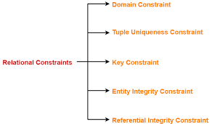

Slide 16
1. Domain Relational Constraint
Values inserted into database should be correct.
It’s a basic form of integrity constraints.
Types
1.1 Required data Constraint
1.2 Check Constraint
1.3 Default Constraint

Slide 17
1.1 Required data Constraint
Ensure that Null value or blank is not present.
In the database some attributes are mandatory.
Student_id int NOT NULL

Slide 18
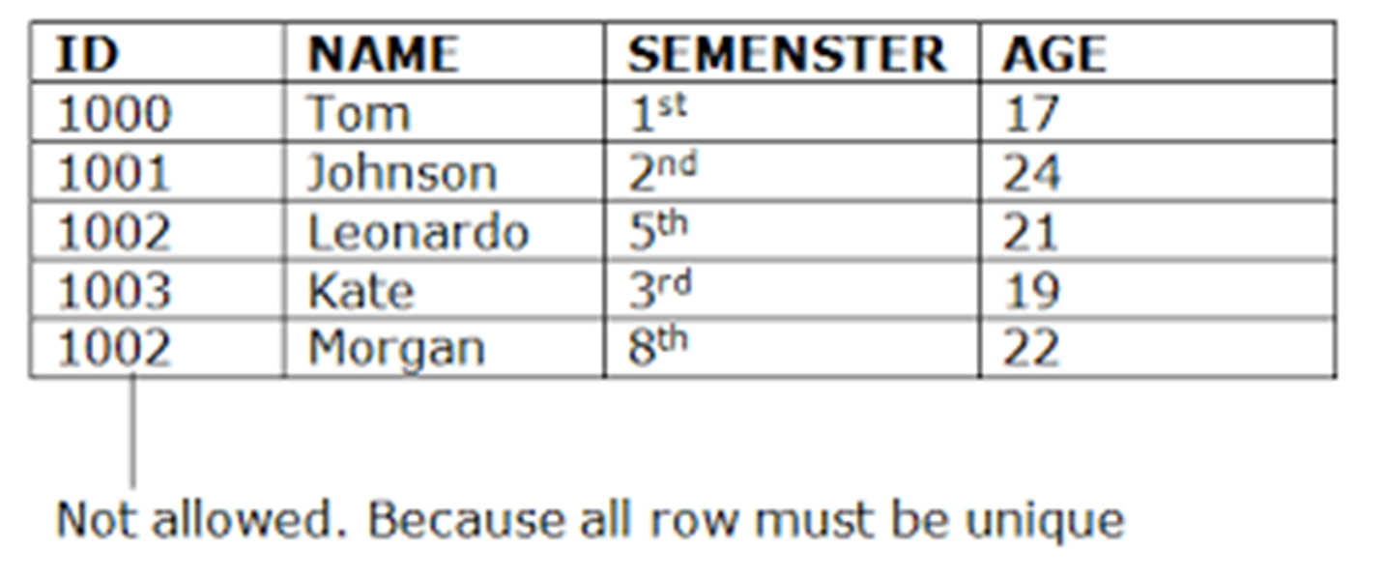

Slide 19
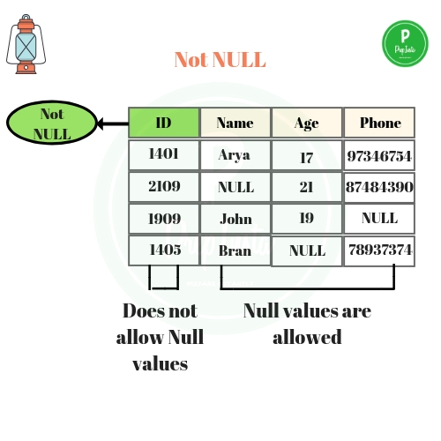

Slide 20
1.2 Check Constraint
Used to ensure that attribute value satisfies specific condition as specified by user requirement.
Employee_gender varchar(1) CHECK (gender IN(‘M’,’F’)
Prevent user from entering incorrect or other data in database table.

Slide 21
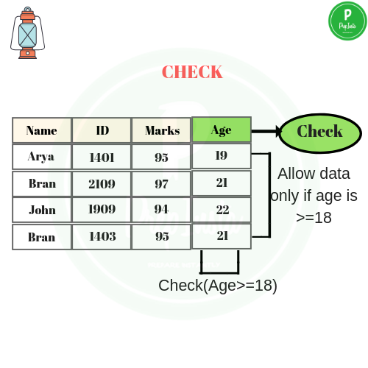

Slide 22
1.3 Default Constraint
Is used to add a default specified value, if attribute value is not provided by user.
Employee_designation varchar(50) DEFAULT ‘UNKNOWN’
If designation is not added then it will consider as by default Unknown. Instead of NULL.

Slide 23
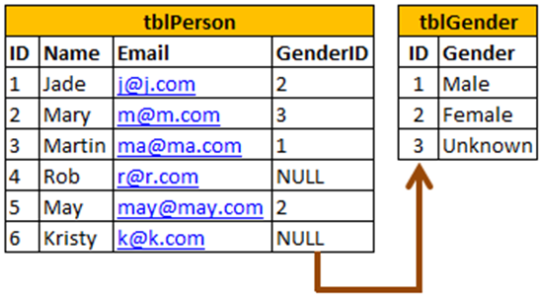

Slide 24
2. Entity Integrity Constraints
Allow us to test whether the tuple inserted into the database are correct or not.
2.1 Unique Constraint
2.2 Primary constraint

Slide 25
2.1 Unique Constraint
No two tuples can have equal value for same attribute.
EMAIL varchar(30) UNIQUE

Slide 26
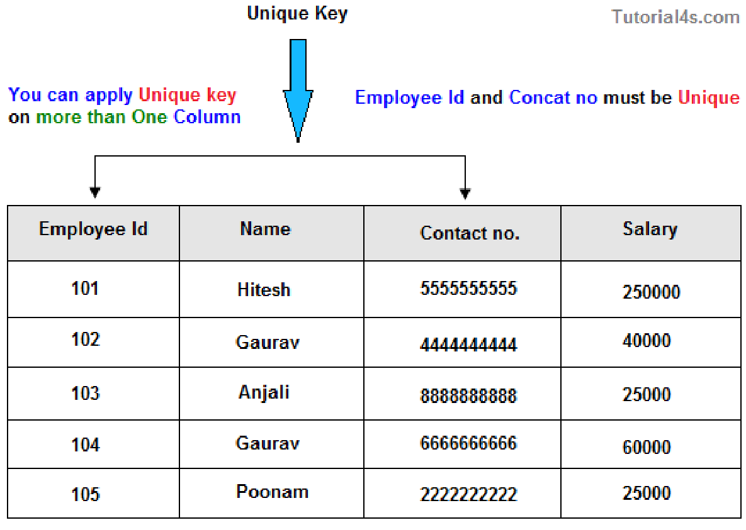

Slide 27
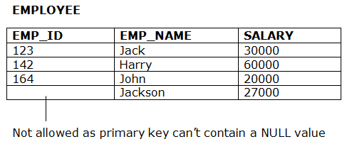
2.2 Primary Key Constraint
Null values not allowed.
Student_id char(50) PRIMARY KEY

Slide 28
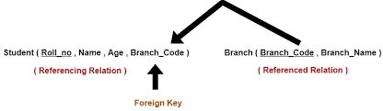
Referential Integrity/Foreign Key
A value appearing in a one table for a given set of attributes also appears for another set of attributes in another relation.

Slide 29
There are following three possible causes of violation of referential integrity constraint-
Cause-01: Insertion in a referencing relation
Cause-02: Deletion from a referenced relation
Cause-03: Updation in a referenced relation

Slide 30
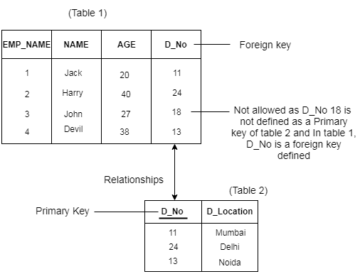

Slide 31
Cause-02: Deletion from a referenced relation
Can not delete CS computer Science from branch table.
It will return foreign key violation error.
Can not update CS to Computer Engineering.

Slide 32
Roll_no | Name | Age | Branch_Code
1 | Rahul | 22 | CS
2 | Anjali | 21 | CS
3 | Teena | 20 | IT
Branch_Code | Branch_Name
CS | Computer Science
EE | Electronics Engineering
IT | Information Technology
Can not add civil in student table

Slide 33
Handling the Violation-
Method-01:
This method involves simultaneously updating those tuples of the referencing relation where the referencing attribute uses the referenced attribute value being updated.
This method of handling the violation is called as On Update Cascade

Slide 34
Method-02:
This method involves aborting or deleting the request for an updation of the referenced relation if the value is used by the referencing relation.

Slide 35
Method-03:
This method involves setting the value being updated in the referenced relation to NULL or some other value in the referencing relation if the referencing attribute uses that value.

Slide 36
Roll_no | Name | Age | Branch_Code
1 | Rahul | 22 | CS
2 | Anjali | 21 | CS
3 | Teena | 20 | IT
4 | Rohan | 18 | Null
Foreign key can be null.
Branch_Code | Branch_Name
CS | Computer Science
EE | Electronics Engineering
IT | Information Technology

Slide 37
Mapping ER to Relational Model
1. Mapping Strong entity(Regular)
2. Mapping Weak entity
3. Mapping Attributes
4. Mapping Relationship
5. Mapping Cardinality
1 to 1
1 to many
Many to many

Slide 38
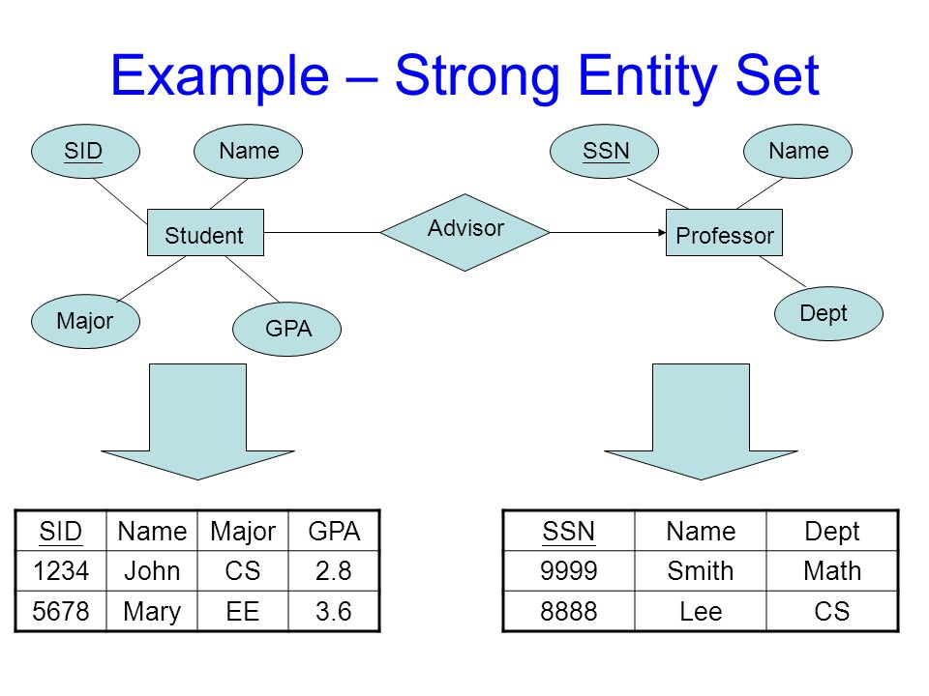

Slide 39
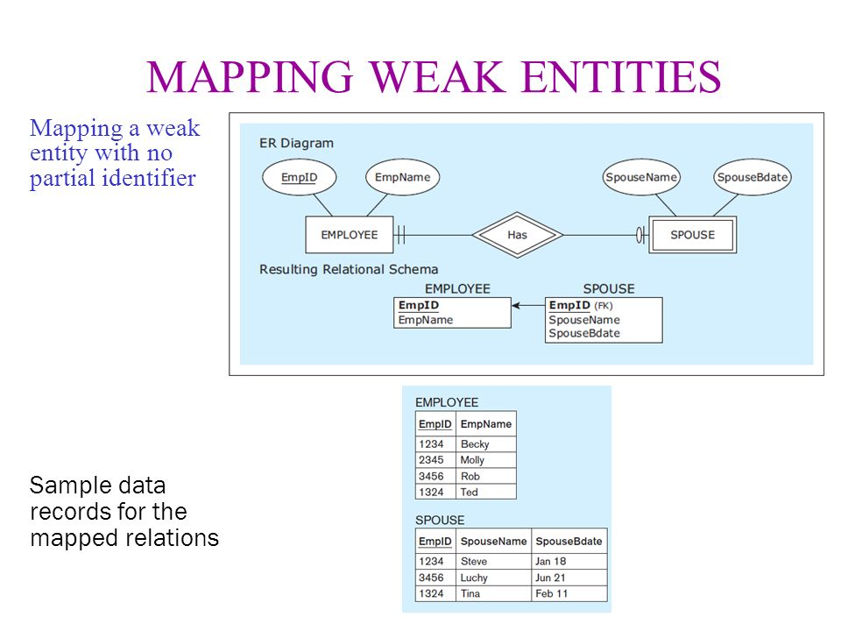

Slide 40
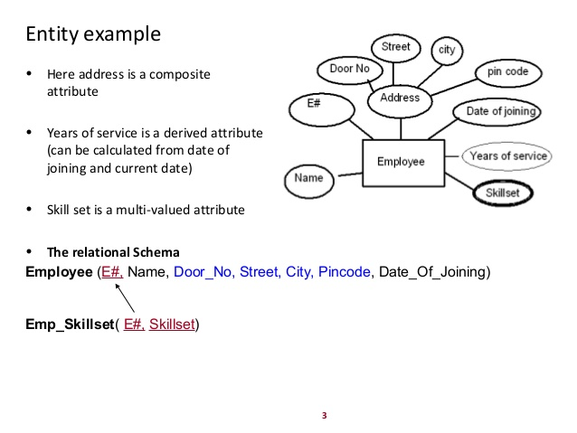

Slide 41
E# | Skill set
1 | c
1 | JAVA
2 | PHP
3 | Android

Slide 42
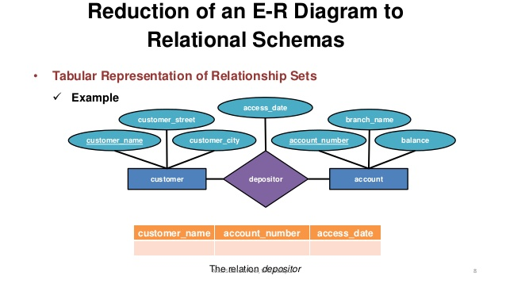

Slide 43
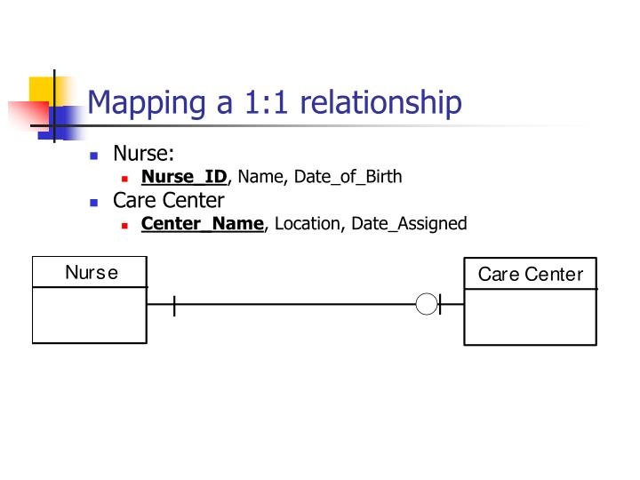

Slide 44
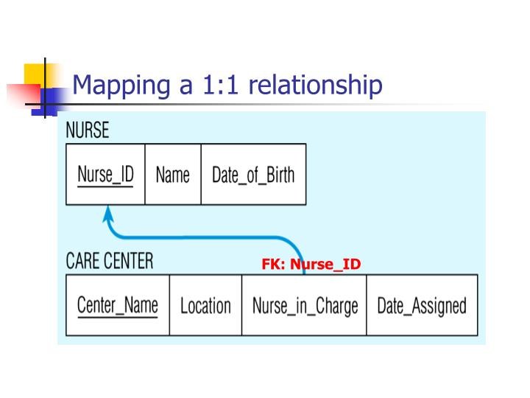

Slide 45
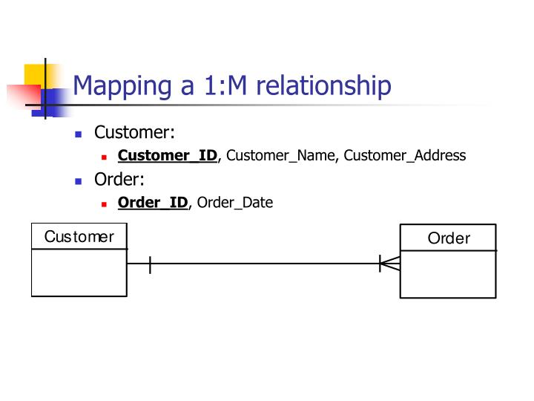

Slide 46
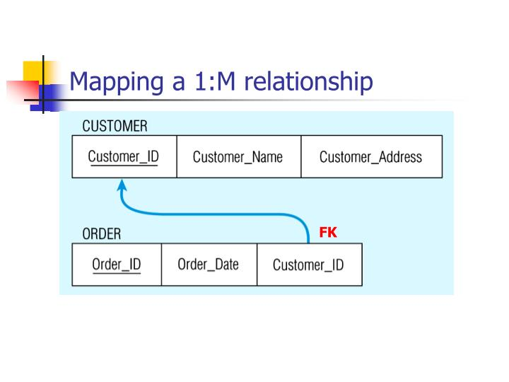

Slide 47
Thank you !

